Slide 1
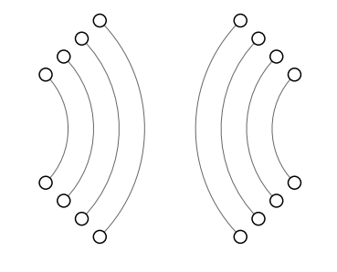
Chapter 03: Communication

Slide 2
Processes
Threads
Topics
Processes and Threads
Process Communication
Communication Models
Multicast Communication
Introduction to threads

Slide 3
Processes
Threads
Threads and Processes
The concept of a process originates from the field of operating systems, where it is generally defied as a program in execution.
In distributed systems, other issues beyond process management and scheduling turn out to be equally or more important.
Introduction to threads

Slide 4
Processes
Threads
Threads
A process is often defied as a program in execution.
Processes form a building block in distributed systems
However their granularity in distributed systems is not sufficient.
Multiple threads per process are more important here.
Introduction to threads

Slide 5
Processes
Threads
Why use threads
Some simple reasons
Avoid needless blocking: a single-threaded process will block when doing I/O; in a multithreaded process, the operating system can switch the CPU to another thread in that process.
Exploit parallelism: the threads in a multithreaded process can be scheduled to run in parallel on a multiprocessor or multicore processor.
Avoid process switching: structure large applications not as a collection of processes, but through multiple threads.
Introduction to threads

Slide 6
Processes
Threads
Using threads at the client side
Multithreaded web client
Hiding network latencies:
Web browser scans an incoming HTML page, and finds that more files need to be fetched.
Each file is fetched by a separate thread, each doing a (blocking) HTTP request.
As files come in, the browser displays them.
Multiple request-response calls to other machines (RPC)
A client does several calls at the same time, each one by a different thread.
It then waits until all results have been returned.
Note: if calls are to different servers, we may have a linear speed-up.
Threads in distributed systems

Slide 7
Processes
Threads
Using threads at the server side
Improve performance
Starting a thread is cheaper than starting a new process.
Having a single-threaded server prohibits simple scale-up to a multiprocessor system.
As with clients: hide network latency by reacting to next request while previous one is being replied.
Better structure
Most servers have high I/O demands. Using simple, well-understood blocking calls simplifies the structure.
Multithreaded programs tend to be smaller and easier to understand due to simplified flow of control.
Threads in distributed systems

Slide 8
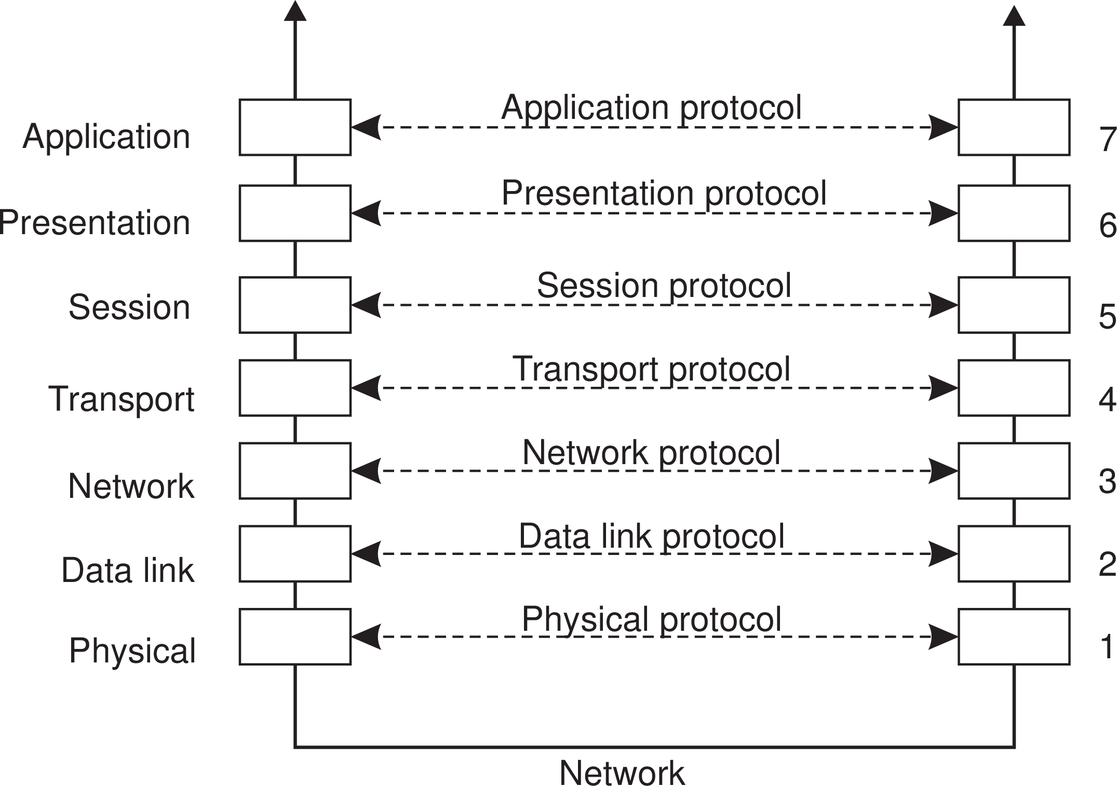
Communication
Foundations
Communication Foundation
Drawbacks
Focus on message-passing only
Often unneeded or unwanted functionality
Violates access transparency
Layered Protocols

Slide 9
Communication
Foundations
Transport Layer
Important
The transport layer provides the actual communication facilities for most distributed systems.
Standard Internet protocols
TCP: connection-oriented, reliable, stream-oriented communication
UDP: unreliable (best-effort) datagram communication
All transport-level communication services offer only transient communication.
Layered Protocols

Slide 10
Middleware layer
Communication Foundations
Observation
Middleware is invented to provide common services and protocols that can be used by many different applications
A rich set of communication protocols
(Un)marshaling of data, necessary for integrated systems
Naming protocols, to allow easy sharing of resources
Security protocols for secure communication
Scaling mechanisms, such as for replication and caching
Note
What remains are truly application-specific protocols... such as?
Layered Protocols

Slide 11
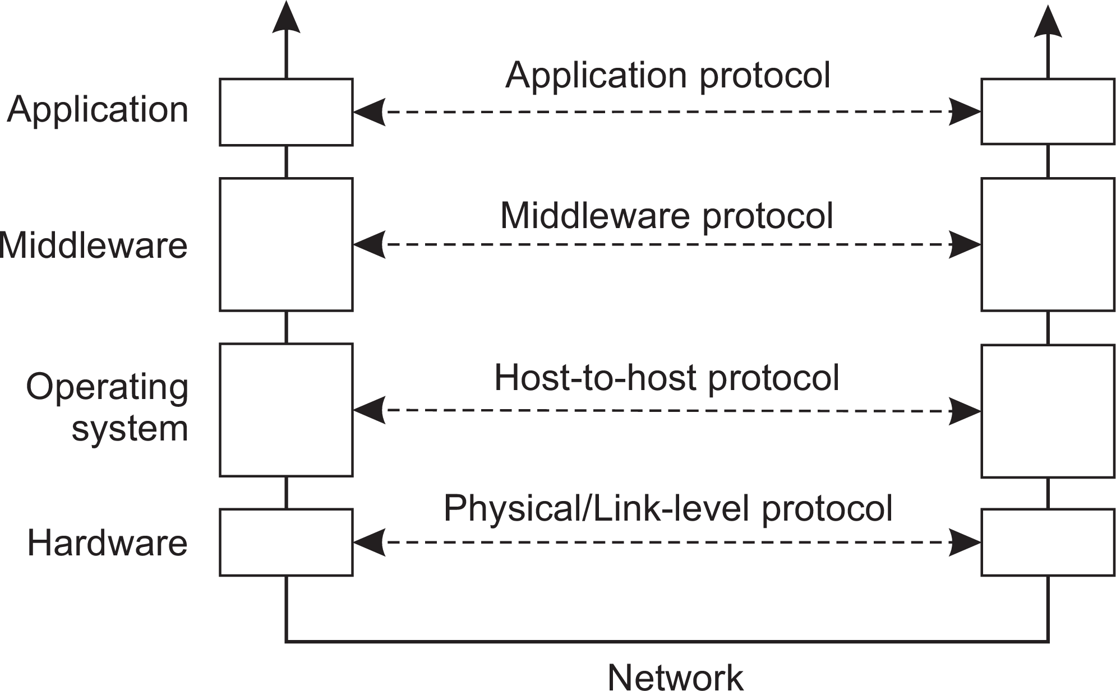
Communication
Foundations
An adapted layering scheme
Layered Protocols

Slide 12
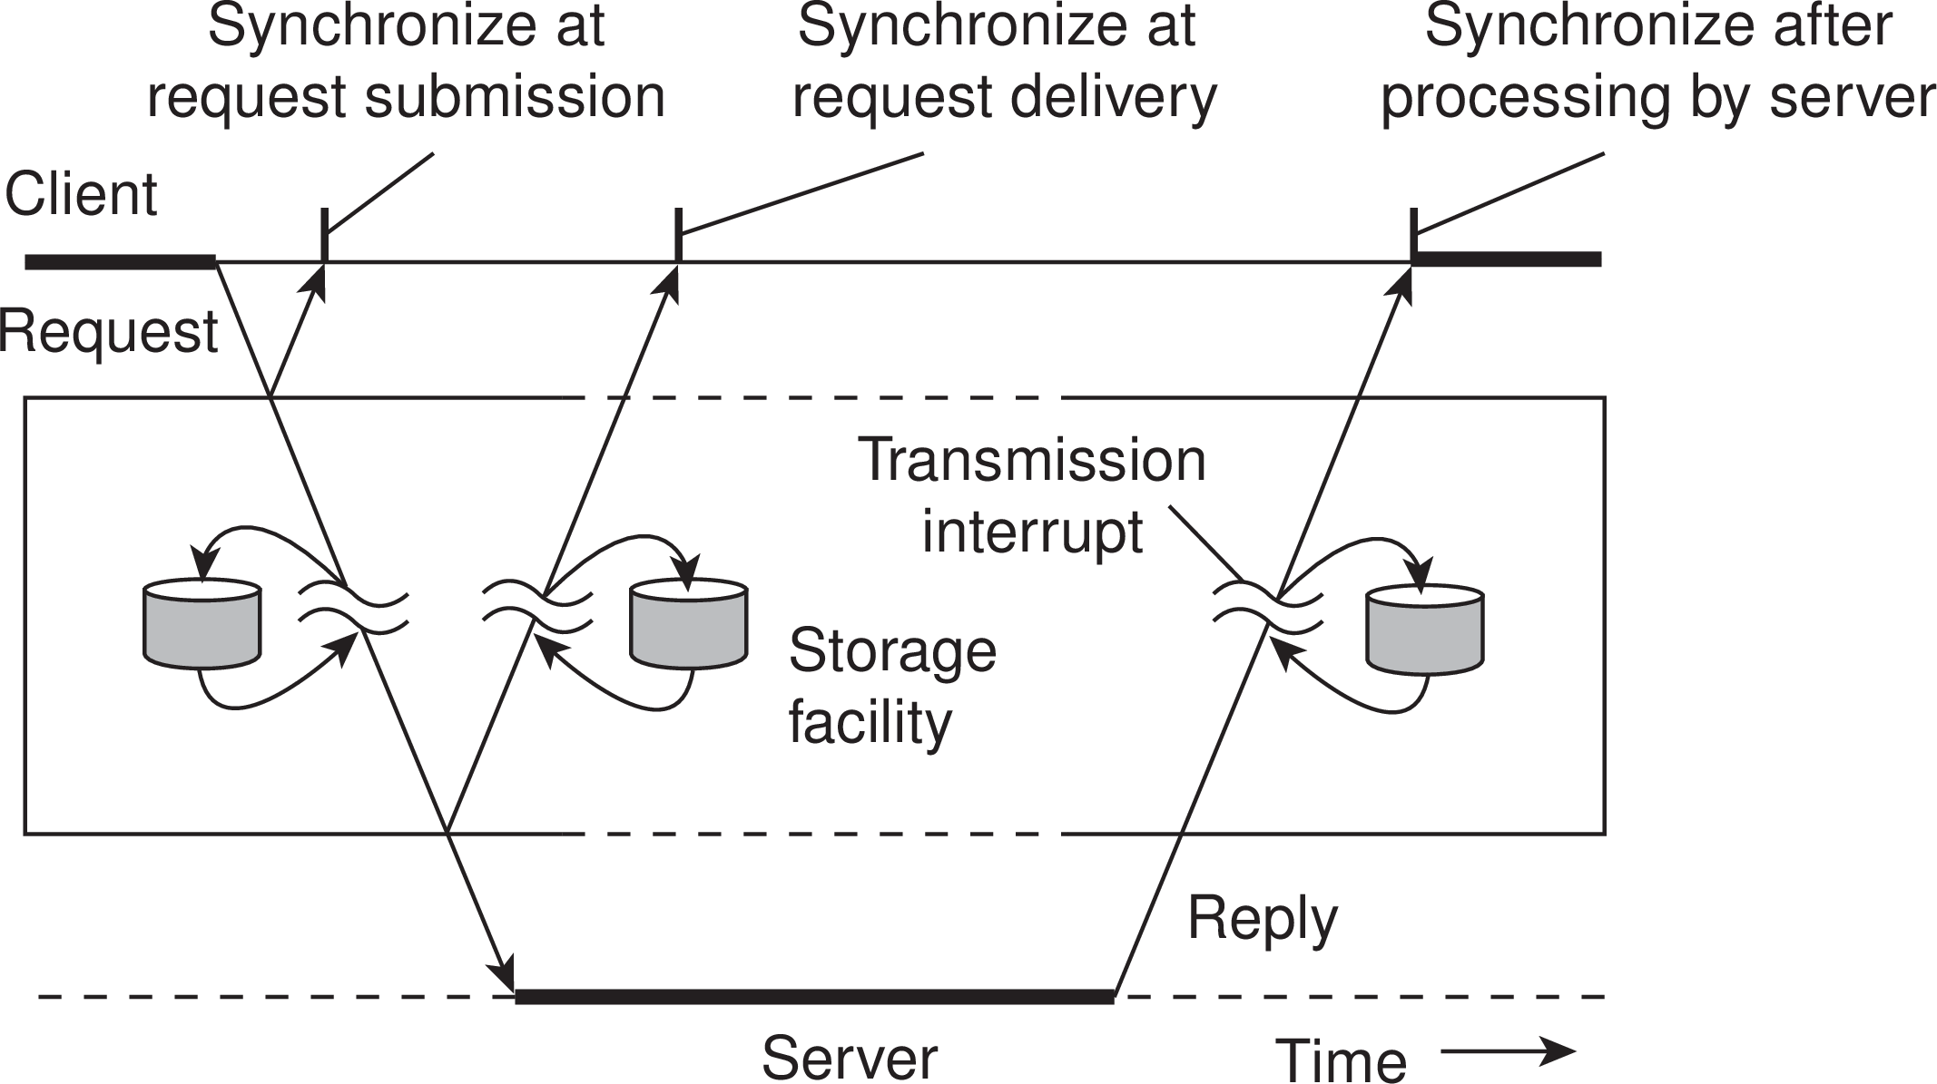
Communication
Foundations
Types of communication
Distinguish...
Transient versus persistent communication
Asynchronous versus synchronous communication
Types of Communication

Slide 13
Communication
Foundations
Types of communication
Transient versus persistent
Transient communication: Comm. server discards message when it cannot be delivered at the next server, or at the receiver.
Persistent communication: A message is stored at a communication server as long as it takes to deliver it.
Types of Communication

Slide 14
Communication
Foundations
Types of communication
Places for synchronization
Asynchronous communication is that a sender continues immediately after it has submitted its message for transmission.
Synchronous communication, the sender is blocked until its request is known to be accepted.
Types of Communication

Slide 15
Communication
Foundations
Client/Server
Some observations
Client/Server computing is generally based on a model of transient synchronous communication:
Client and server have to be active at the time of communication
Client issues request and blocks until it receives reply
Server essentially waits only for incoming requests, and subsequently processes them
Types of Communication

Slide 16
Communication
Foundations
Client/Server
Some observations
Client/Server computing is generally based on a model of transient synchronous communication:
Client and server have to be active at the time of communication
Client issues request and blocks until it receives reply
Server essentially waits only for incoming requests, and subsequently processes them
Drawbacks of synchronous communication
Client cannot do any other work while waiting for reply
Failures have to be handled immediately: the client is waiting
The model may simply not be appropriate (mail, news)
Types of Communication

Slide 17
Communication
Foundations
Messaging
Message-oriented middleware
Aims at high-level persistent asynchronous communication:
Processes send each other messages, which are queued
Sender need not wait for immediate reply, but can do other things
Middleware often ensures fault tolerance
Types of Communication

Slide 18
Remote Procedure Call (RPC)
Communication Remote procedure call
Basic RPC operation

Slide 19
Communication Models
Communication Remote procedure call
Basic RPC operation

Slide 20
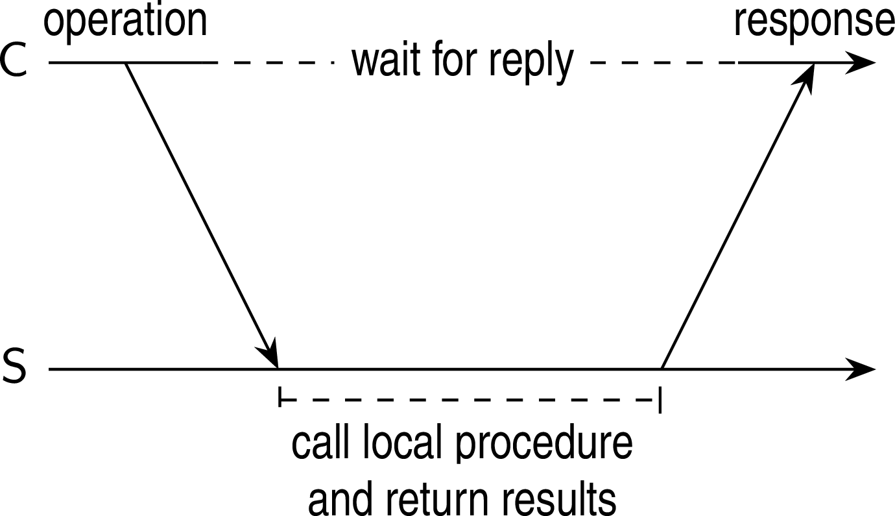
Basic RPC operation
Communication Remote procedure call
Observations
Application developers are familiar with simple procedure model
Well-engineered procedures operate in isolation (black box)
There is no fundamental reason not to execute procedures on separate machine
Conclusion
Communication between caller & callee can be hidden by using procedure-call mechanism.
Basic RPC operation

Slide 21
Basic RPC operation
Communication Remote procedure call
In RPC, the proposal was to allow programs to call procedures located on other machines.
When a process on a machine A calls a procedure on a machine B, the calling process on A is suspended, and execution of the called procedure takes place on B.
Basic RPC operation

Slide 22
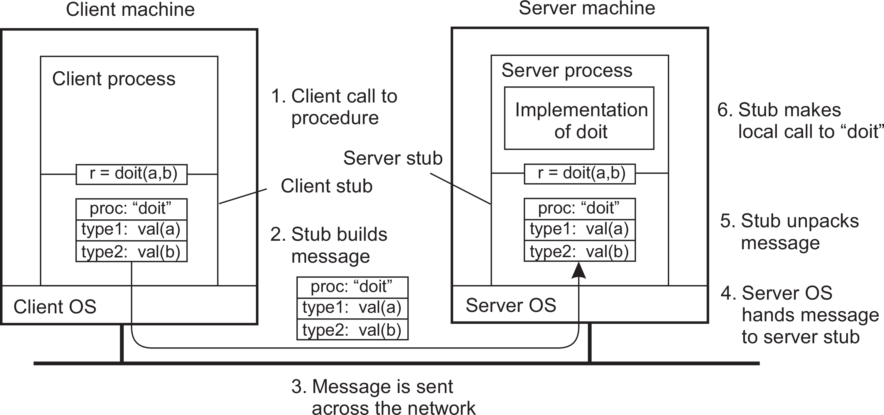
Communication
Remote procedure call
Basic RPC operation
Client procedure calls client stub.
Stub builds message; calls local OS.
OS sends message to remote OS.
Remote OS gives message to stub.
Stub unpacks parameters; calls server.
Server does local call; returns result to stub.
Stub builds message; calls OS.
OS sends message to client’s OS.
Client’s OS gives message to stub.
Client stub unpacks result; returns to client.
Basic RPC operation

Slide 23
Challenges in RPC
Communication Remote procedure call
RPC implementation is not easy as it seems in defining it.
different machines with different address spaces
issues with parameters and results
Machines can crush
Complex error handling
Most of these can be dealt with, and RPC is a widely used technique that underlies many distributed systems.
Parameter passing

Slide 24
RPC: Parameter passing
Communication Remote procedure call
There’s more than just wrapping parameters into a message
Client and server machines may have different data representations
Client and server have to agree on the same encoding:
Issues in byte ordering (due machine architecture)
Byte reordering in network communication
How are basic data values represented (integers, floats, characters)
How are complex data values represented (arrays, unions)
Conclusion
Client and server need to properly interpret messages, transforming them into machine-dependent representations.
Parameter passing

Slide 25
RPC: Parameter passing
Communication Remote procedure call
Packing parameters into a message is called parameter marshaling.
The reverse process is called Parameter Unmarshaling!.
The solution to the problems is to transform data that is to be sent to a machine- and network-independent format.
Role of Marshaling and Unmarshaling!
Parameter passing

Slide 26
Asynchronous RPCs
Communication Remote procedure call
As in conventional procedure calls, when a client calls a remote procedure, the client will block until a reply is returned.
This strict request-reply behavior is unnecessary when there is no result to return, or may hinder efficiency when multiple RPCs need to be performed.
RPC might be implemented asynchronously.
Variations on RPC

Slide 27
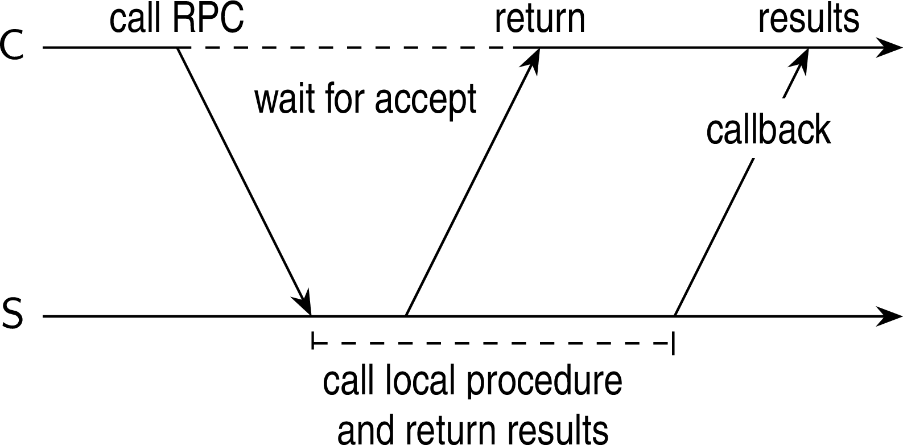
Asynchronous RPCs
Communication Remote procedure call
As in conventional procedure calls, when a client calls a remote procedure, the client will block until a reply is returned.
This strict request-reply behavior is unnecessary when there is no result to return, or may hinder efficiency when multiple RPCs need to be performed.
RPC might be implemented asynchronously.
Variations on RPC

Slide 28
Asynchronous RPCs
Communication Remote procedure call
Deferred synchronous RPC: the client fist calls the server, waits for the acceptance, and continues.
When the results become available, the server sends a response message that leads to a callback at the client’s side.
One-way RPCs: the client does not wait for an acknowledgment of the server’s acceptance of the request. (When reliability is not guaranteed, the client cannot know for sure whether its request will be processed)
Variations on RPC

Slide 29
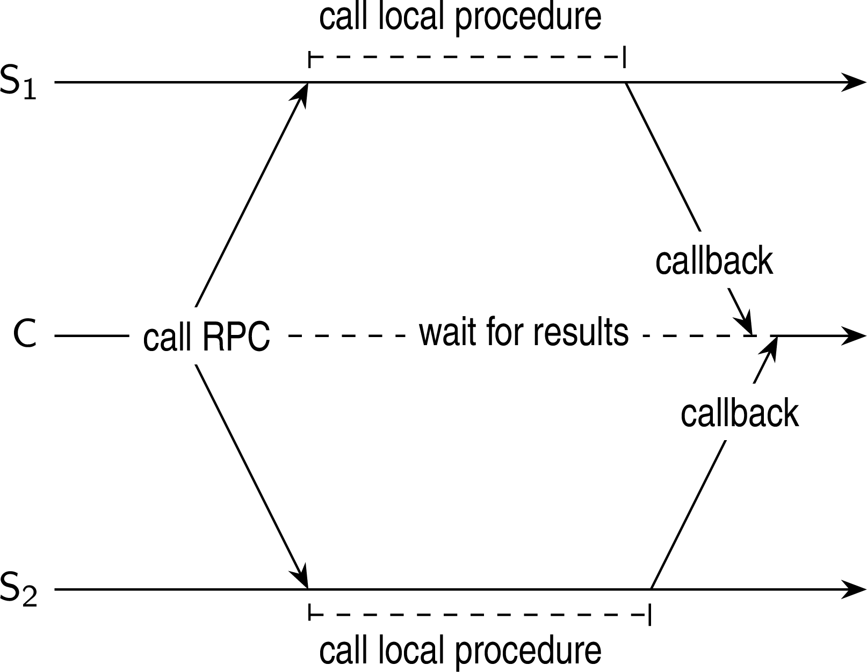
Communication
Remote procedure call
Sending out multiple RPCs
Essence
Sending an RPC request to a group of servers.
Variations on RPC

Slide 30
Communication
Remote procedure call
Message Oriented Communication
Variations on RPC

Slide 31
Communication
Remote procedure call
Message Oriented Communication
Transient Communication
Simple Transient Messaging (Sockets)
Advanced Transient Messaging (ZeroMQ)
Message Passing Interface (MPI)
Transient Communication
Persistent Messaging (Message Queue)
Variations on RPC

Slide 32
Communication
Remote procedure call
Message Oriented Communication
Remote procedure calls contribute to hiding communication in distributed systems.
Unfortunately, it isn’t always appropriate to use RPC.
(In particular, if the receiver is not executing when the a request is issued, alternative communication services are needed.)
Communication via messaging is a viable option!
Variations on RPC

Slide 33
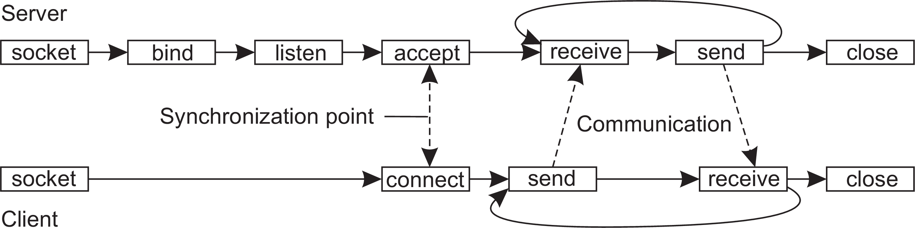
Communication
Message-oriented communication
Transient messaging: sockets
Berkeley socket interface
Operation | Description
socket bind listen accept connect send receive close | Create a new communication end point Attach a local address to a socket Tell operating system what the maximum number of pending connection requests should be Block caller until a connection request arrives Actively attempt to establish a connection Send some data over the connection Receive some data over the connection Release the connection
Simple transient messaging with sockets

Slide 34
Making sockets easier to work with
Communication Message-oriented communication
Observation
Sockets are rather low level and programming mistakes are easily made.
However, the way that they are used is often the same (such as in a client-server setting).
Sockets essentially support only TCP or UDP
Advanced transient messaging

Slide 35
Making sockets easier to work with
Communication Message-oriented communication
Alternative: ZeroMQ
ZeroMQ Provides a higher level of abstraction by pairing sockets: one for sending messages at process P and a corresponding one at process Q for receiving messages. All communication is asynchronous.
Advantages:
To make network programming easier
To expand beyond the functionality offered by existing networking protocols
To make better use of local resources
Advanced transient messaging

Slide 36
Making sockets easier to work with
Communication Message-oriented communication
Alternative: ZeroMQ
Like in the Berkeley approach, ZeroMQ also provides sockets through which all communication takes place.
Actual message transmission generally takes place over TCP connections
All communication is essentially connection-oriented
However, setting up, and maintaining connections is kept mostly under the hood: an application programmer need not bother with those issues.
Advanced transient messaging

Slide 37
Making sockets easier to work with
Communication Message-oriented communication
Alternative: ZeroMQ
ZeroMQ sockets also support many-to-one and one-to-many (multicasting ) communication.
ZeroMQ is that communication is asynchronous
Advanced transient messaging

Slide 38
Making sockets easier to work with
Communication Message-oriented communication
Alternative: ZeroMQ
Three patterns
Request-reply (request socket REQ, reply socket REP)
Publish-subscribe (PUB and SUB sockets - implements multicasting)
Pipeline
Advanced transient messaging

Slide 39
Communication
Message-oriented communication
Message Passing Interfaces (MPI)
When lots of flexibility is needed
Sockets were deemed insufficient for two reasons.
First, they were at the wrong level of abstraction by supporting only simple send and receive operations.
Second, sockets had been designed to communicate across networks using general-purpose protocol stacks such as TCP/IP.
Advanced transient messaging

Slide 40
Communication
Message-oriented communication
MPI: When lots of flexibility is needed
MPI assumes communication takes place within a known group of processes.
Each group is assigned an identifier.
Each process within a group is also assigned a (local) identifier.
A (groupID, processID) pair therefore uniquely identifies the source or destination of a message, and is used instead of a transport-level address.
Advanced transient messaging

Slide 41
Communication
Message-oriented communication
MPI: When lots of flexibility is needed
Representative operations
Operation | Description
MPI BSEND | Append outgoing message to a local send buffer
MPI SEND | Send a message and wait until copied to local or remote buffer
MPI SSEND | Send a message and wait until transmission starts
MPI SENDRECV | Send a message and wait for reply
MPI ISEND | Pass reference to outgoing message, and continue
MPI ISSEND | Pass reference to outgoing message, and wait until receipt starts
MPI RECV | Receive a message; block if there is none
MPI IRECV | Check if there is an incoming message, but do not block
Advanced transient messaging

Slide 42
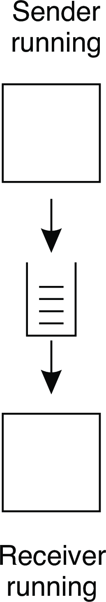
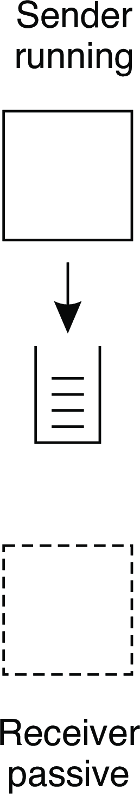
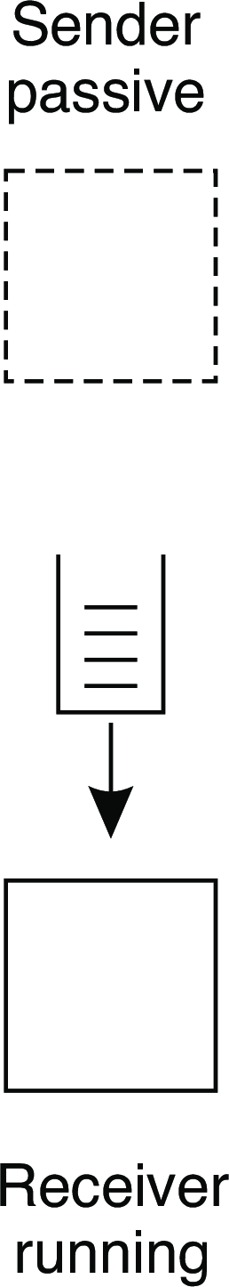
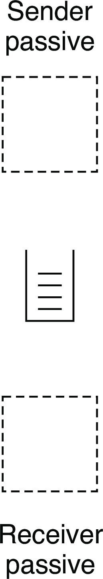
Communication
Message-oriented communication
Queue-based messaging
Four possible combinations
Message-oriented persistent communication

Slide 43
Message-oriented middleware (Message Queuing)
Communication Message-oriented communication
Essence
Asynchronous persistent communication through support of middleware-level queues. Queues correspond to buffers at communication servers.
Operations
Operation | Description
PUT | Append a message to a specified queue
GET | Block until the specified queue is nonempty, and remove the first message
POLL | Check a specified queue for messages, and remove the first. Never block
NOTIFY | Install a handler to be called when a message is put into the specified queue
Message-oriented persistent communication

Slide 44
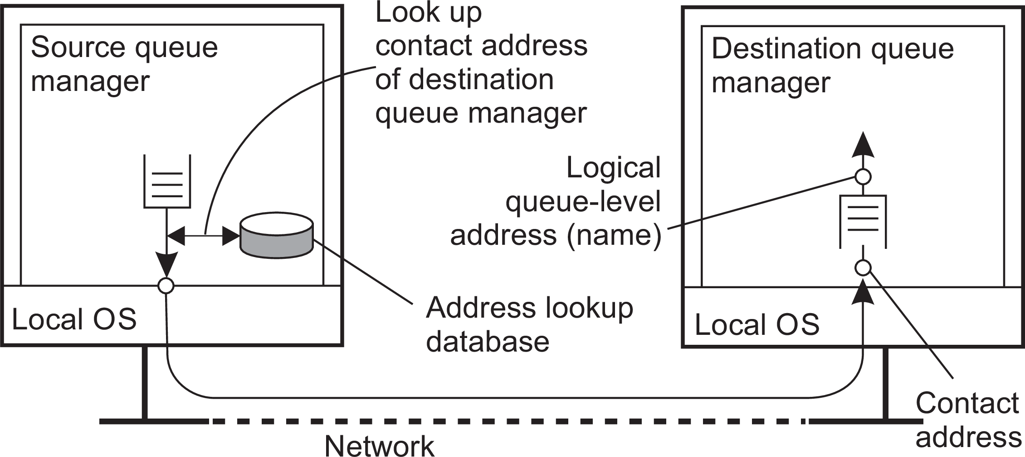
General model
Communication Message-oriented communication
Queue managers
Queues are managed by queue managers. An application can put messages only into a local queue. Getting a message is possible by extracting it from a local queue only ⇒ queue managers need to route messages.
Routing
Message-oriented persistent communication

Slide 45
Message broker
Communication Message-oriented communication
Observation
Message queuing systems assume a common messaging protocol: all applications agree on message format (i.e., structure and data representation)
Broker handles application heterogeneity in an MQ system
Transforms incoming messages to target format
Very often acts as an application gateway
May provide subject-based routing capabilities (i.e., publish-subscribe capabilities)
Message-oriented persistent communication

Slide 46
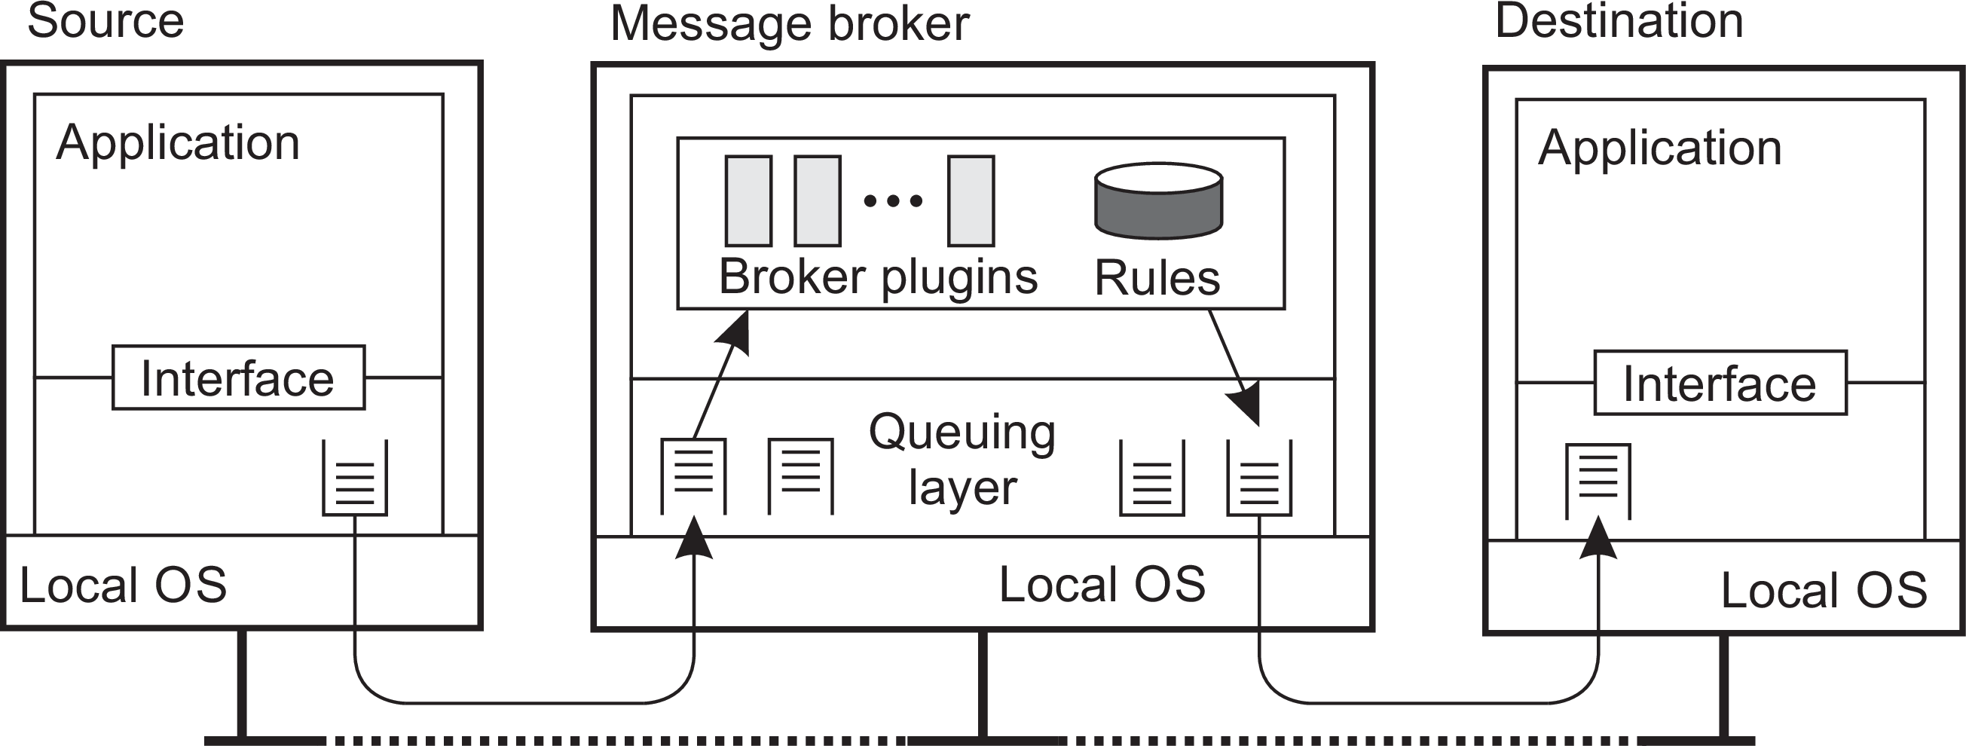
Communication
Message-oriented communication
Message broker: general architecture
Message-oriented persistent communication

Slide 47
Application-level multicasting
Communication Multicast communication
Essence
Organize nodes of a distributed system into an overlay network and use that network to disseminate data:
Oftentimes a tree, leading to unique paths
Alternatively, also mesh networks, requiring a form of routing
Application-level tree-based multicasting

Slide 48
Application-level multicasting in Chord
Communication Multicast communication
Basic approach
Initiator generates a multicast identifier mid .
Lookup succ(mid ), the node responsible for mid .
Request is routed to succ(mid ), which will become the root.
If P wants to join, it sends a join request to the root.
When request arrives at Q:
Q has not seen a join request before ⇒ it becomes forwarder; P
becomes child of Q. Join request continues to be forwarded.
Q knows about tree ⇒ P becomes child of Q. No need to forward join request anymore.
Application-level tree-based multicasting

Slide 49
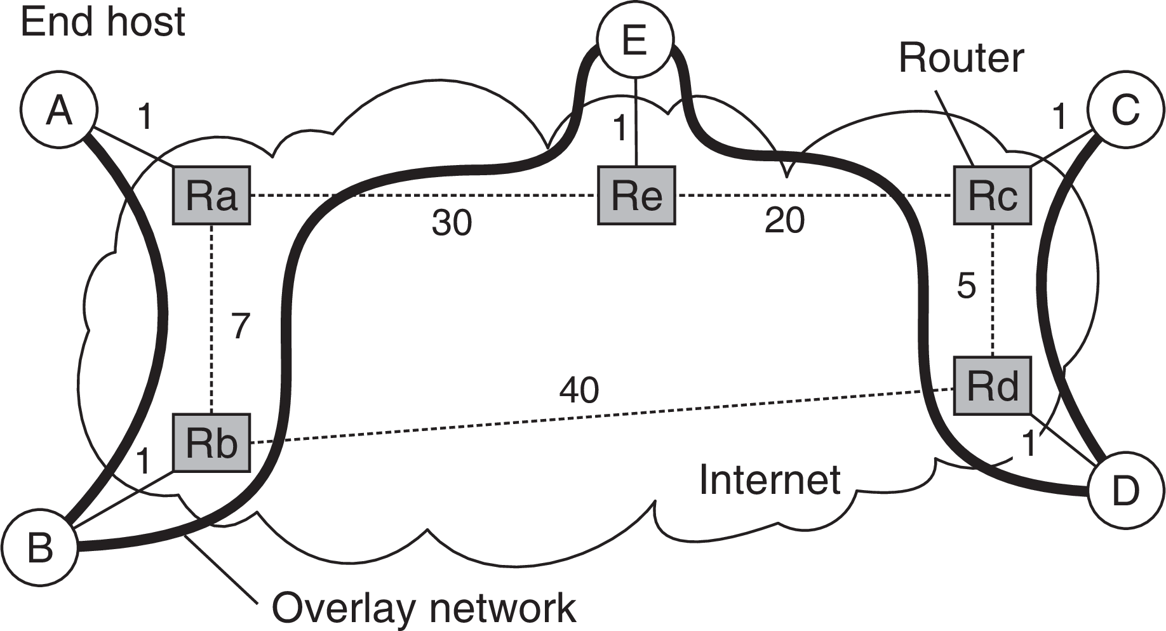
Communication
Multicast communication
ALM: Some costs
Different metrics
Link stress: How often does an ALM message cross the same physical link? Example: message from A to D needs to cross ⟨Ra, Rb⟩ twice.
Stretch: Ratio in delay between ALM-level path and network-level path. Example: messages B to C follow path of length 73 at ALM, but 47 at network level ⇒ stretch = 73/47.
Application-level tree-based multicasting

Slide 50
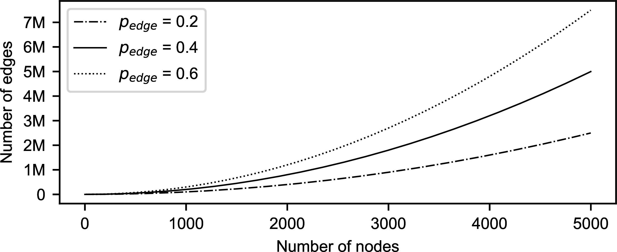
Flooding
Communication Multicast communication
Essence
P simply sends a message m to each of its neighbors. Each neighbor will forward that message, except to P, and only if it had not seen m before.
Flooding-based multicasting

Slide 51
Flooding
Communication Multicast communication
Essence
P simply sends a message m to each of its neighbors. Each neighbor will forward that message, except to P, and only if it had not seen m before.
Variation
Let Q forward a message with a certain probability p_{flood} , possibly even dependent on its own number of neighbors (i.e., node degree) or the degree of its neighbors.
Flooding-based multicasting

Slide 52
Communication
Multicast communication
Epidemic protocols
Assume there are no write–write conflicts
Update operations are performed at a single server
A replica passes updated state to only a few neighbors
Update propagation is lazy, i.e., not immediate
Eventually, each update should reach every replica
Two forms of epidemics
Anti-entropy: Each replica regularly chooses another replica at random, and exchanges state differences, leading to identical states at both afterwards
Rumor spreading: A replica which has just been updated (i.e., has been contaminated), tells several other replicas about its update (contaminating them as well).
Gossip-based data dissemination

Slide 53
Communication
Multicast communication
Anti-entropy
Principle operations
A node P selects another node Q from the system at random.
Pull: P only pulls in new updates from Q
Push: P only pushes its own updates to Q
Push-pull: P and Q send updates to each other
Observation
For push-pull it takes O(log(N)) rounds to disseminate updates to all N nodes (round = when every node has taken the initiative to start an exchange).
Gossip-based data dissemination

Slide 54
Anti-entropy: analysis
Communication Multicast communication
Basics
Consider a single source, propagating its update. Let p_{i} be the probability that a node has not received the update after the i^{th} round.
Analysis: staying ignorant
With pull, p_{i +1} = (p_{i} )²: the node was not updated during the i^{th} round and should contact another ignorant node during the next round.
With push, p = p (1 −
1 (N−1
)(1−p )
−1
i +1 i
)
i
≈ p e (for small p and large
N−1
i i
N): the node was ignorant during the i^{th} round and no updated node chooses to contact it during the next round.
With push-pull: (p_{i} )² · (p_{i} e⁻¹)
Gossip-based data dissemination

Slide 55
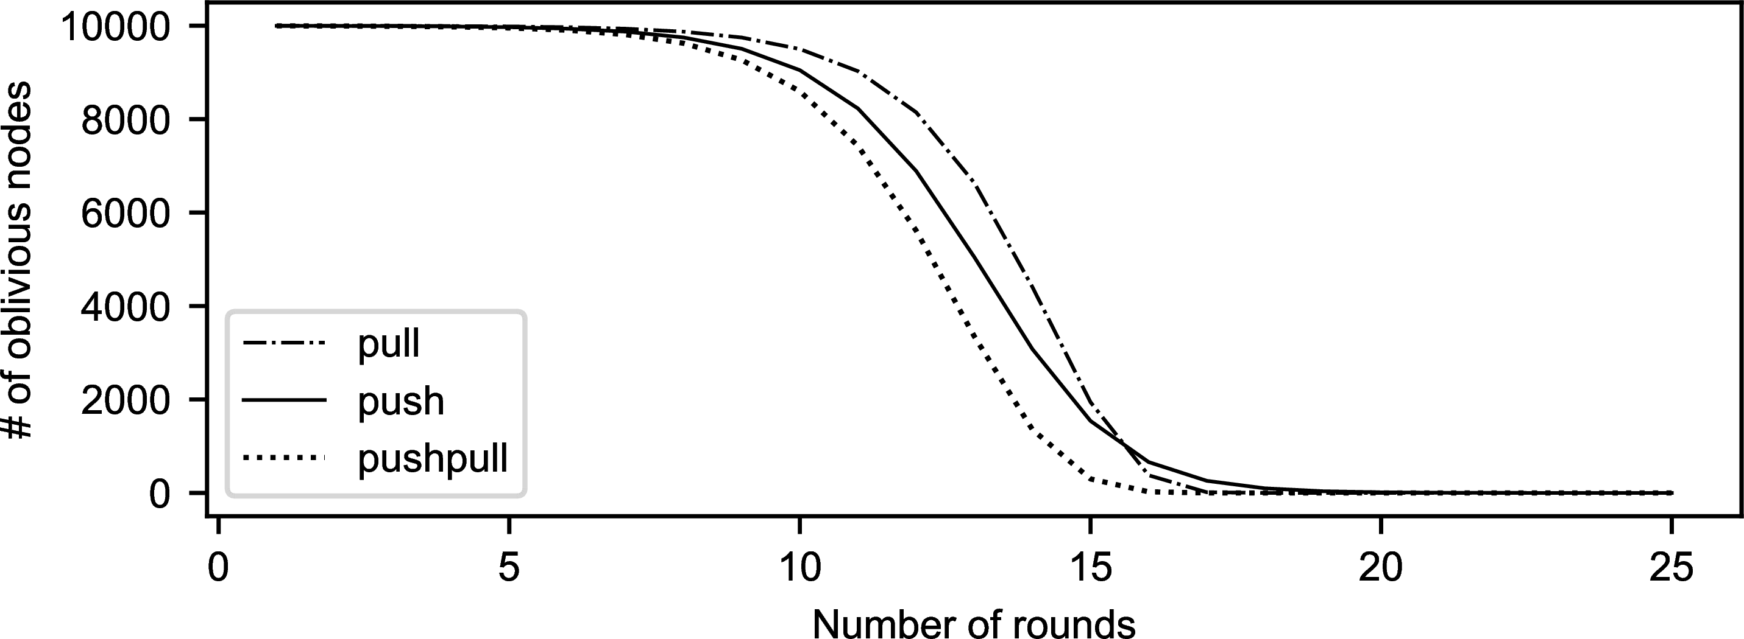
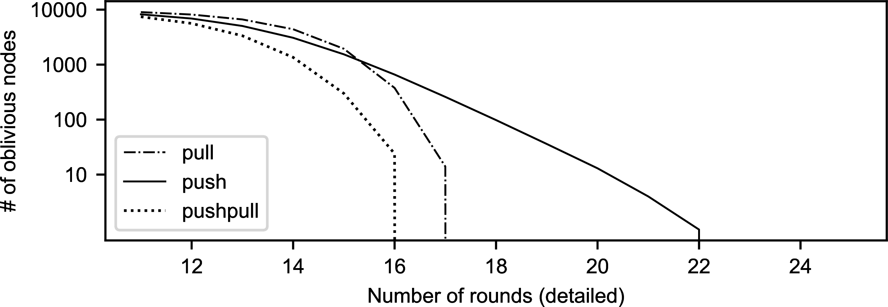
Communication
Multicast communication
Anti-entropy performance
Gossip-based data dissemination

Slide 56
Rumor spreading
Communication Multicast communication
Basic model
A server S having an update to report, contacts other servers. If a server is contacted to which the update has already propagated, S stops contacting other servers with probability p_{stop}.
Observation
If s is the fraction of ignorant servers (i.e., which are unaware of the update), it can be shown that with many servers
_{s = e}−(1/p_{stop}+1)(1−s)
Gossip-based data dissemination

Slide 57
Formal analysis
Communication Multicast communication
Notations
Let s denote fraction of nodes that have not yet been updated (i.e., susceptible; i the fraction of updated (infected) and active nodes; and r the fraction of updated nodes that gave up (removed).
From theory of epidemics
ds/dt
di/dt
⇒ di/ds
⇒ i (s)
= −s · i
= s · i −p_{stop} · (1 −s) · i
=
=
^{p}stop
−(1 + p_{stop}) +
s
−(1 + p_{stop}) · s + p_{stop} · ln(s) + C
Wrap up
i (1) = 0 ⇒ C = 1 + p_{stop} ⇒ i (s) = (1 + p_{stop}) · (1 −s) + p_{stop} · ln(s). We are looking for the case i (s) = 0, which leads to s = e^{−(1/pstop+1)(1−s)}
Gossip-based data dissemination

Slide 58
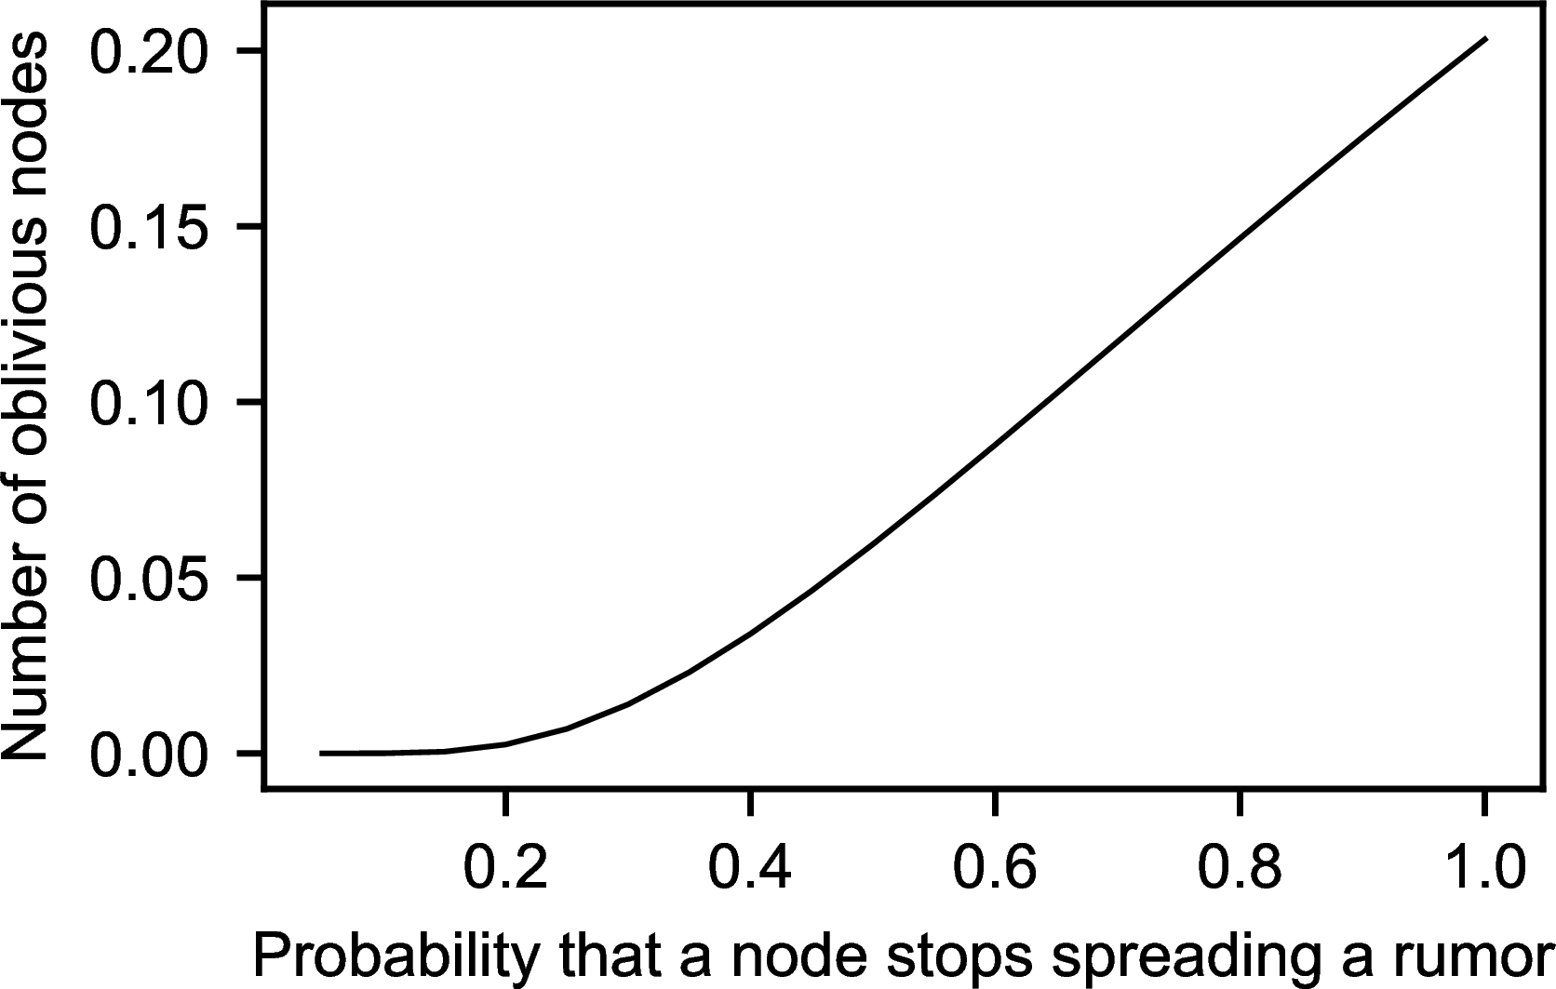
Communication
Multicast communication
Rumor spreading
The effect of stopping
Consider 10,000 nodes
^{1/p}stop | s | Ns
1 | 0.203188 | 2032
2 | 0.059520 | 595
3 | 0.019827 | 198
4 | 0.006977 | 70
5 | 0.002516 | 25
6 | 0.000918 | 9
7 | 0.000336 | 3
Gossip-based data dissemination

Slide 59
Communication
Multicast communication
Rumor spreading
The effect of stopping
Consider 10,000 nodes
^{1/p}stop | s | Ns
1 | 0.203188 | 2032
2 | 0.059520 | 595
3 | 0.019827 | 198
4 | 0.006977 | 70
5 | 0.002516 | 25
6 | 0.000918 | 9
7 | 0.000336 | 3
Note
If we really have to ensure that all servers are eventually updated, rumor spreading alone is not enough
Gossip-based data dissemination

Slide 60
Deleting values
Communication Multicast communication
Fundamental problem
We cannot remove an old value from a server and expect the removal to propagate. Instead, mere removal will be undone in due time using epidemic algorithms
Solution
Removal has to be registered as a special update by inserting a death certificate
Gossip-based data dissemination

Slide 61
Deleting values
Communication Multicast communication
When to remove a death certificate (it is not allowed to stay for ever)
Run a global algorithm to detect whether the removal is known everywhere, and then collect the death certificates (looks like garbage collection)
Assume death certificates propagate in finite time, and associate a maximum lifetime for a certificate (can be done at risk of not reaching all servers)
Note
It is necessary that a removal actually reaches all servers.
Gossip-based data dissemination

Slide 62
Shared Memory Process Communication Model
The shared memory in the shared memory model is the memory that can be simultaneously accessed by multiple processes.
This is done so that the processes can communicate with each other.
All POSIX systems, as well as Windows operating systems use shared memory.

Slide 63
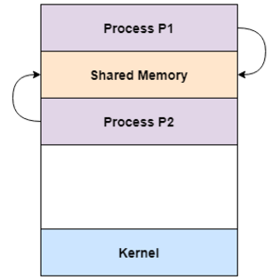
Shared Memory Process Communication Model

Slide 64
Shared Memory Process Communication Model
An advantage of shared memory model is that memory communication is faster as compared to the message passing model on the same machine.
However, shared memory model may create problems such as synchronization and memory protection that need to be addressed.

